Slide 1
Agriculture Monitoring and Irrigation automation System
SHOBIT VERMA
21JE0893
MECHANICAL ENGINEERING

Slide 2
UNDERSTANDING THE PROBLEM
To develop an iot based project that will help us monitor the moisture in the soil and to irrigate it when necessary. The detection of the moisture shall be done by the soil moisture sensor and if the water content is low then we can irrigate the plant with a nearby small water pump .

Slide 3
COMPONENTS REQUIRED
Arduino uno R3
Soil moisture sensor module
Single 5V relay module
Small water pump
Small breadboard
Jumper wires
9V Battery

Slide 4

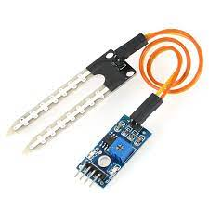
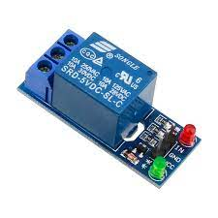
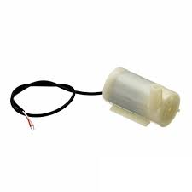
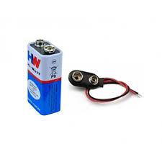
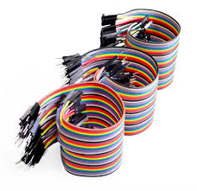
COMPONENTS REQUIRED
ARDUINO UNO R3
SOIL MOISTURE SENSOR
5V RELAY MODULE
SMALL WATER PUMP
9V BATTERY
JUMPER WIRES

Slide 5
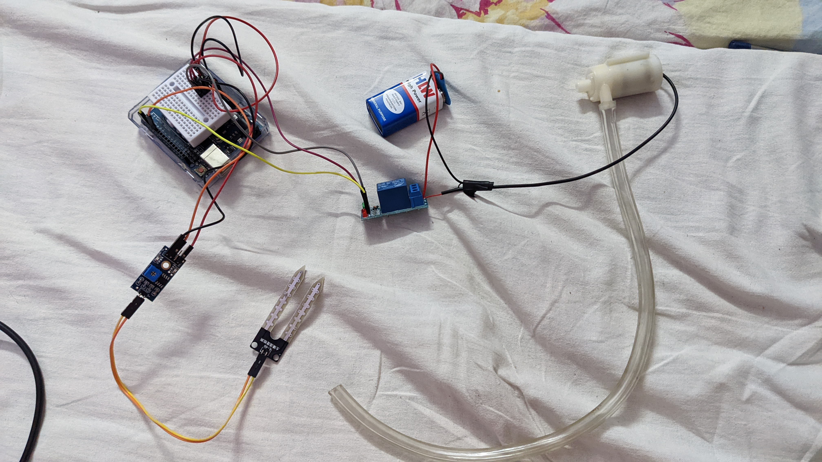
CONNECTIONS AND CIRCUIT DIAGRAM

Slide 6
VIDEO DEMONSTRATION
https://drive.google.com/drive/folders/1hWxC_008_2gjnyb0McVaEjI6dfHVLdaU?usp=sharing
Refer the above drive link.

Slide 7
CODE
int water; //random variable
void setup() {
pinMode(3,OUTPUT); //output pin for relay board, this will sent signal to the relay
pinMode(6,INPUT); //input pin coming from soil sensor
}
void loop() {
water = digitalRead(6); // reading the coming signal from the soil sensor
if(water == HIGH) // if water level is full then cut the relay
{
digitalWrite(3,LOW); // low is to cut the relay
}
else
{
digitalWrite(3,HIGH); //high to continue proving signal and water supply
}
delay(400);
}

Slide 8
THANK YOU !!!

